Slide 1
RECOMMENDER SYSTEM
Movie Recommendation
GROUP 1
BI ZHANMING
HAN GUANGHUI
YANG HEXU
ZHOU CHENLU
Notes:
hello everyone, this is group1, our team members are a,b,c,d
today we are going to introduce a hybrid recommendation system for IMDB movies

Slide 2
Contents
Business Problem | Explain the current business pain points and the problems we are about to solve
Dataset Overview | Description of the IMDB data set
Data Processing | Explain how we processed the data set
Algorithms and Experiments | Introduce all the models we use and conduct experiments
Results and Comparison | The experimental results are obtained, analyzed and compared
Prospect of the Future | Description of the future development of this system
Notes:
here is our present outline. starting with the business problem, firstly we go through the dataset, and then we will introduce our data processing methods, then the experiments algorithm we have applied.finally we compare the peformance of all the models and discuss some addtional aspects

Slide 3
01
Business Problem
Notes:
Now, let's starts with our business problem

Slide 4
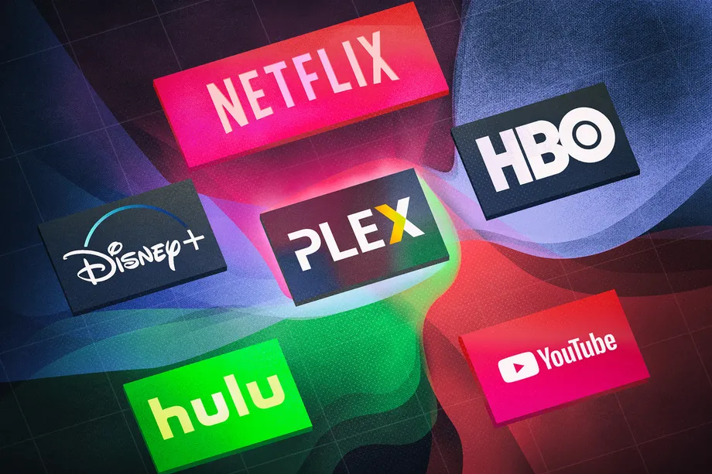

Business Problem
Streaming platforms struggle with cold-start recommendations due to insufficient data from new users and new items. Poor recommendations can lead to user loss and reduced profits. Finding a solution to this issue is crucial for platform growth.
Notes:
nowadays many streaming platforms are struggling with cold-start recommendations due to insufficient data from new users and new items.Poor recommendations can lead to user loss and reduced profits. Finding a solution to this issue is crucial for platform growth.

Slide 5
Task
To solve these recommendation issues, we use both collaborative filtering and content-based models together to make better recommendations. By combining these two methods, we can create more accurate and personalized recommendations for each user.
Combined
Model
Collaborative Filtering Model
Content-Based Model
Notes:
To address this challenge, we applied hybrid recommendation structure that combine collaborative filtering, content-based approaches to provide more accurate and personalized suggestions even with limited initial data.

Slide 6
Dataset Overview
01
02
03
04
movies.csv
rating.csv
This dataset contains 10,329 Movies and their respective Genres they cover.
The dataset contains information about 668 users' 105,339 ratings to 10,325 movies, including the time of submission of their feedbacks​
tmdb_5000_credits.csv
tmdb_5000_movies.csv
The dataset contains contains details of 4,803 movies and its cast and crew members​
The dataset contains more details of 4,803 movies, including budget, keywords, overview and etc.
Notes:
now, let's take a look at the dataset.
our dataset consists of 4 subdatasets. the first two datasets are mainly used for collabprating filterining training, including dataset movies and ratings.
they provides essential metadata on the timsamp and users raitngs on different movies of different genres
Then,the other two datasets provide additional details to enrich movie items.
they contains details on movie content including the cast and crew memebers, budget and revenue, popularity and vote counts,as well as tagline and overviews etc.
By intergrating these four datasets, we developed a hybrid recommend system and enhance the recommendation quality.
But before we dive into the hybrid structure, firstly let us take a detailed look at the dataset and discussed about the data processing.

Slide 7
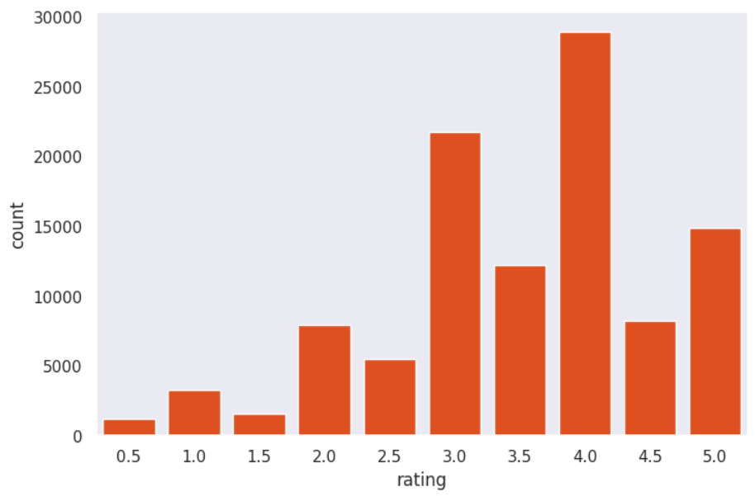
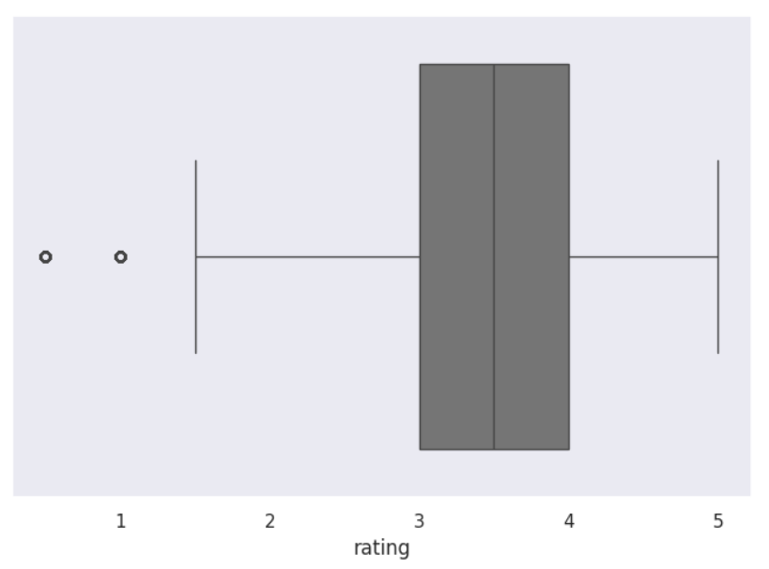
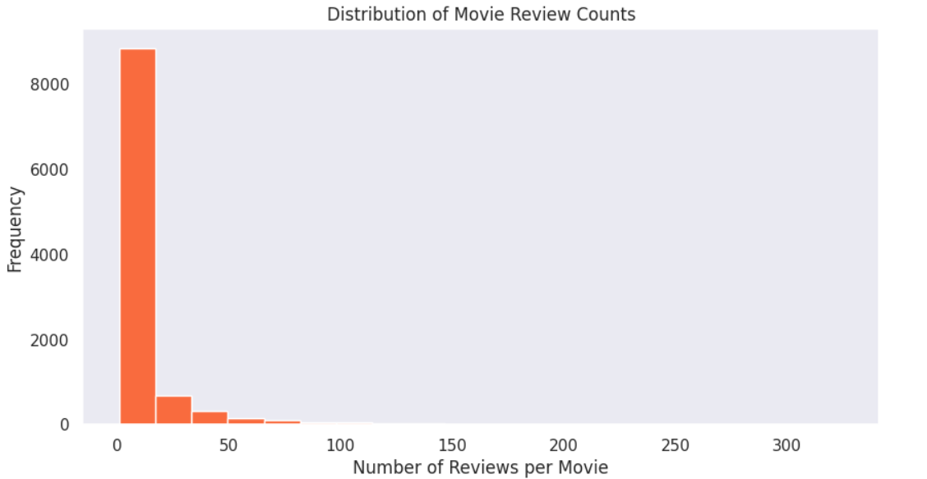
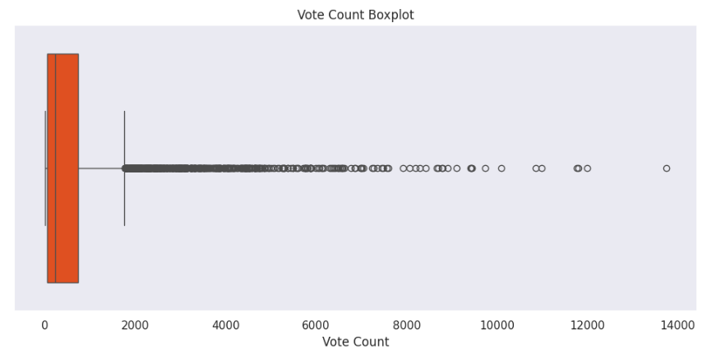
Dataset Insight
Balancing pop and non-pop content
More personalized recommendations
small number of popular movies attract a disproportionately high number of reviews and votes
Highly right-skewed distribution
Median rating is approximately 3.5
highest count of ratings is at 4.0
Ratings are mainly
concentrated in the mid-to-high range
Notes:
we can see from the rating distribution charts, the median rating is approximately 3.5, with the highest count of ratings being at 4.0.
Which shows that most users tend to rate movies in the mid-to-high range,indicating that users generally give favorable ratings.
what's more, we see a highly right-skewed distribution in the data. This means a small number of popular movies attract a disproportionately high number of reviews and votes.
The imbalancing between popular and non-popular content is quite a common issue on recommend system. so later we try to apply different algorithm as well as data processing method to solve that.

Slide 8
02 Data Processing
Notes:
Here we come to our data processing

Slide 9
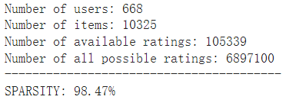
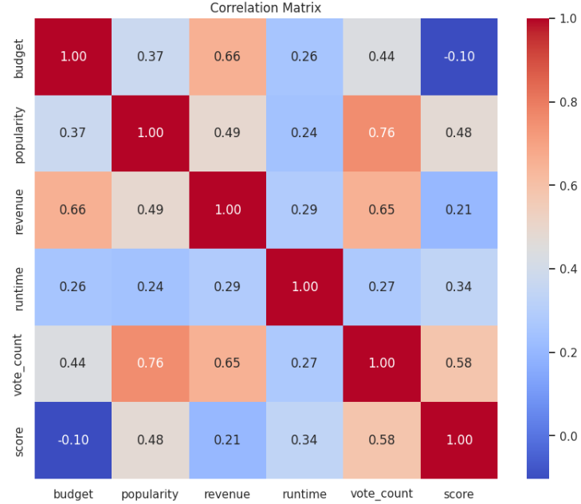
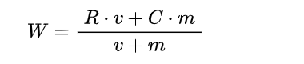
Data Processing
Duplicates, missing values, errors
98.47% Data Sparsity
Dataset split and combination
TF-IDF tokenizer
Correlation analysis
Data Cleaning
Feature Selection
Feature Encoding
One-hot code on genres
Label encoding on other categorical data
Index mapping for libFM
Standard Scale on numerical data
Cyclical Timestamp
Weighed Vote by IMDB formula
Feature Scaling
split
5-Fold cross-validation
Rating threshold = 3.5
Notes:
Our data processing pipline includes 5 steps. after handling duplicates, missing values, and errors in the data cleaning stage, we splied some coulumns such as cast and crew to get more clean features. after cleanning the data, we have identified the 98.47% sparsity on rating matrix.
In the second stage, we use TF-IDF tokenizer to extarct keywords from overviews as new feature columns. We have also use correlation analysis to discard some highly correlative features.
For example, we have found the budget and the revenue pair ,the vote count and the popularity pair are quite dependent on each other so we decide to just use one of them.
Then we come to the feature encodeing stage,we apply one-hot encoding on genres and label encoding on other categorical data and index mapping is alo used to fit the data format required by libFM.
After that we standardize numerical data such as budget, runtime to ensure consistency.For timestamps, we use a cyclical transformation to capture temporal patterns.
We also use the weighted vote formula from IMDB to enhance the importance of different ratings.
Finally we applied 5-fold cross-validation split on the processed data ensure robust evaluation. And accroding the data distribution,we also We use a rating threshold of 3.5 to distinguish between positive and negative ratings.

Slide 10
03
Algorithms and Experiments
Notes:
now next is our algorithm and experiments.

Slide 11
Experiments
DATA
EXPLOREATION
FEATURE ENGINEERING
HYBRID RECOMMENDATION
EVALUATION METRICS
ANALYSIS& EXPLIAN
DATA
PROCESSING
DATE
SPLIT
MODEL TRAINNING
MODEL COMPARISON
Notes:
Just a quick review of the process, now we have came to the hybrid structure.

Slide 12
Hybrid Recommend
Rating Data
100k ratings
10k movies
WMF
NCF
UserId, MovieId,
rating,
Genre,
Timstamp
Content Data
4.8k movies
54% of total content data
CTR
FM
DeepFM
49% ratings
26% movies 100% Users
Overview,
Budget,
runtime,
Cast,
Director,
Weighted vote
Content-Based
Notes:
After the processing the data, we can have datadsets like these. first is out user-item interactive matrix,second is our movie content dataset.
then we can have a combined dataset. unfrtunately they are not perfect match, which scenario is quite similar to out reality. after combination, we can see that the combined data takes 50% of total rating record but covers 100% users,which means that a least we can have a full picture of the users prefernce on our dataset. in additon, here we also got some new items which is not inclueded in the rating matrix.
here are the feature columns provided by the datasets,
and finally we have applied a hybrid model like this. for user-item matrix, we have apllied wmf and ncf for collaborating filtering first.
after intergrating more content features, we use CTR,FM,Deep FM models.And for the our-of matrix content data,we calculte the cosimilaity of each movie items based on their tokenized features to get the top 10 recommendations
now we pass the time to hexu

Slide 13
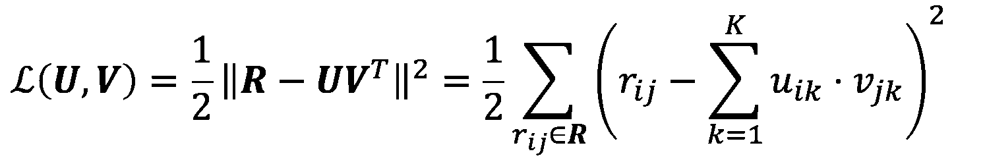
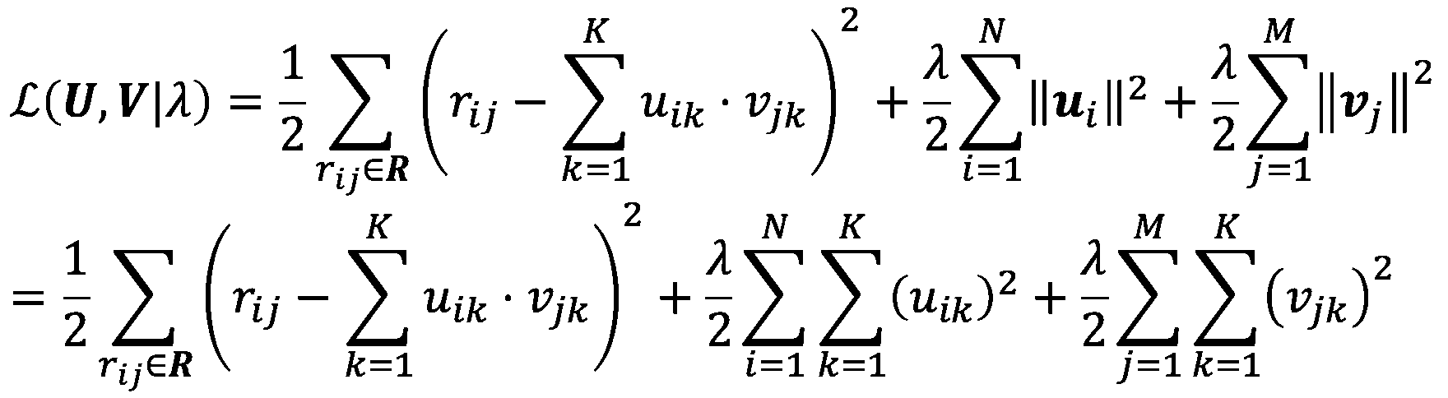
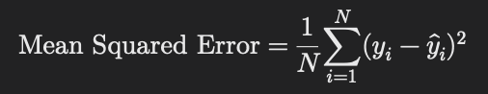
Models based on MF
Loss Function
MF-Baseline
WMF
NCF
Notes:
These are algorithm of models based on the ratings only. And we all had learned these models in the class.
So, I'll just briefly introde the difference of them.
The main idea of collaborative filter algorithm is to find the latent weight matrix of users and items, we optimize these weight by this loss function.
And the difference is WMF added the regularzation and NCF are using neural network to get the end point.

Slide 14
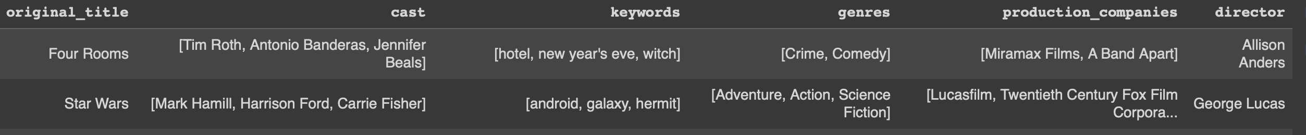
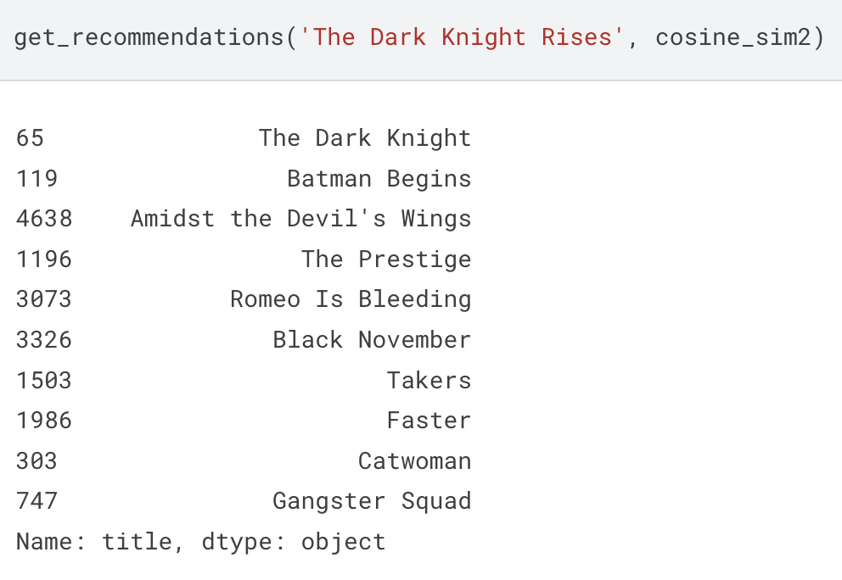
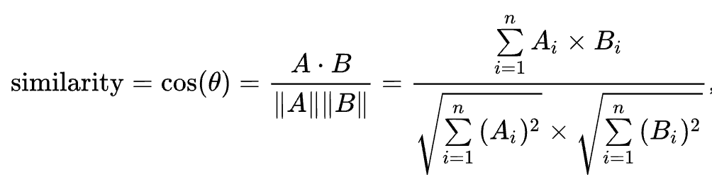
Content-Based Recommendation
Features for Vectorzier
Example
Cos similarity
Notes:
For content based recommendation, we first extract the features which we think is important to indicate the users' preference.
They are cast list, keywords generes p....
After we extracted these text features, we used CountVectorizer to transfrom text into vectors, so we can calculate the cos similarity of different movies, and based on it to recommend movies to users.(Dot product of two vectors divided their length)
And here we can see the example, users can input one movie they like, and we will recommend 10 movies for him.

Slide 15
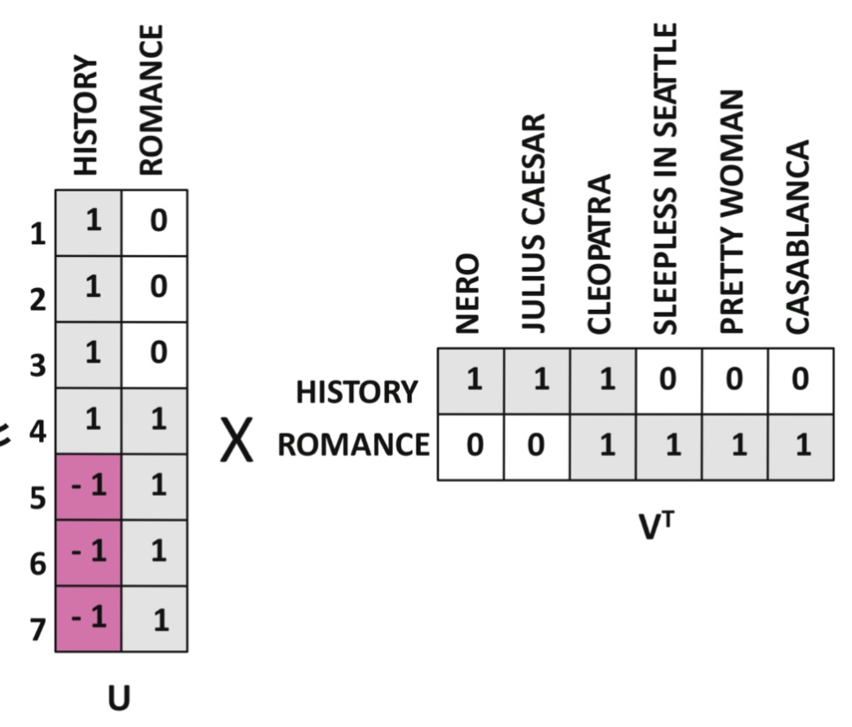
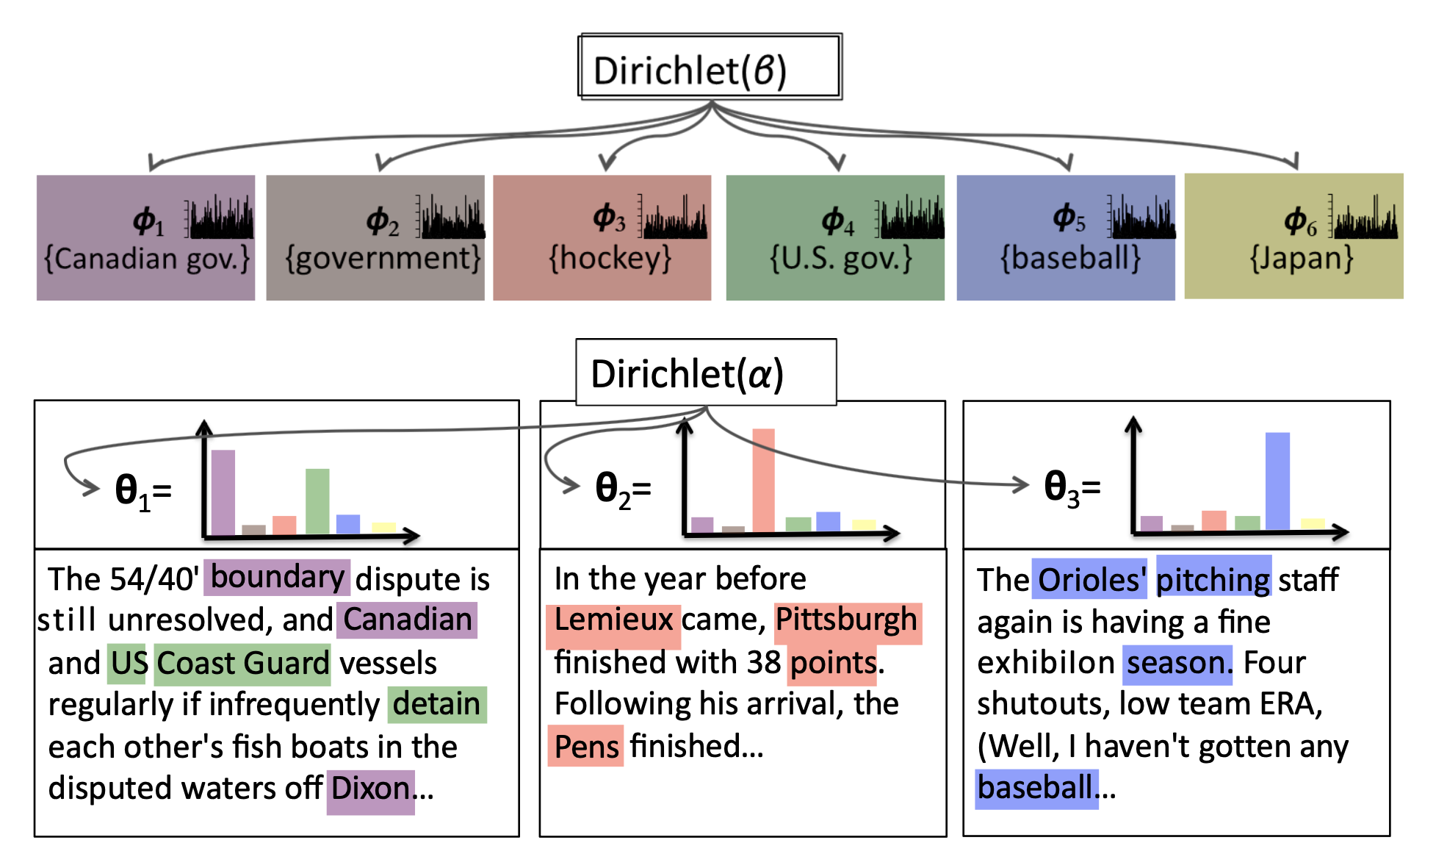
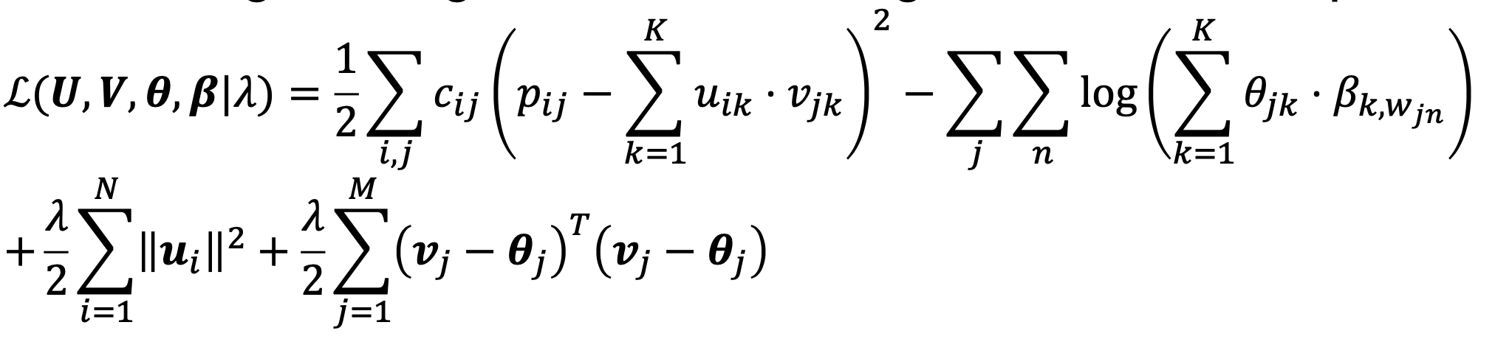
CTR(Collaborative Topic Regression)
MF
LDA
Loss:
Notes:
The next model is CTR(Collaborative Topic Regression), it's a hybrid recommendation algorithm.
Latent Dirichlet Allocation
We can find the latent topics from textual information by LDA model and combine it with the user-item interaction matrix to provide a more accurate recommendations.

Slide 16
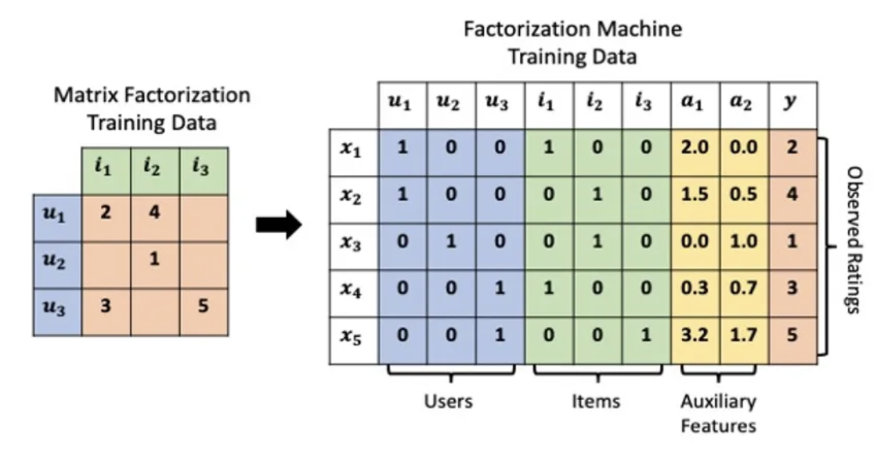
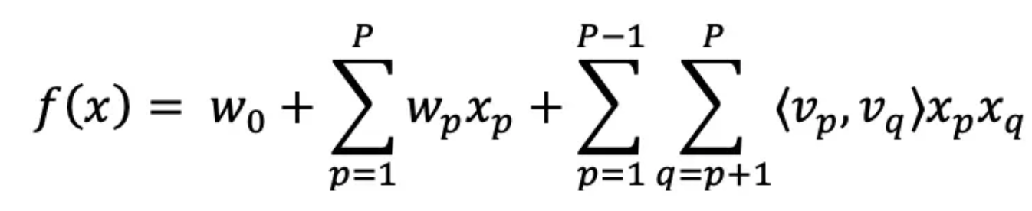
FM
Notes:
Beside the mulitmodality model, we also ultlized factorization machine to do recommendation based on context.
We can see from the function, FM can help us capture the interactions between pairs of features.

Slide 17
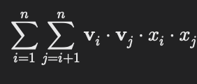
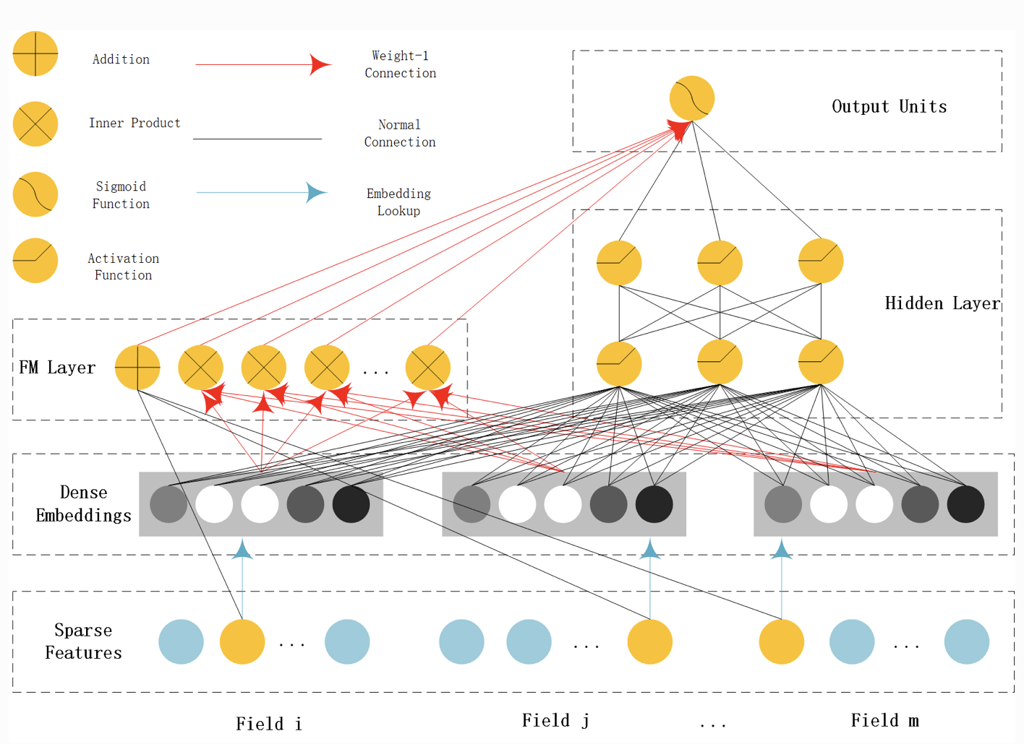
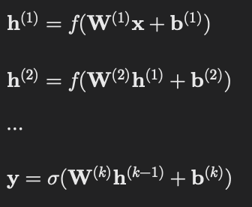
DeepFM
Lower order features(FM):
Higher order features(DNN):
Notes:
And our last model is DeepFM, it's consisted of two parts, one is factorization Machine and the other one is Deep Neural Network.
Just like what I said, FM can only capture interactions between pairs of features. Which we called lower order features.
But in DeepFM, each feature is represented by an embedding vector and was passed into both FM part and MLP part,and in the MLP part,it's all full-connected layers which means we can learn the interactions between more than pair of features.
And one more benefit is that we can deal with Dense features like the budget of movies, scores of movies by embedding.
The embedding vector of FM and input to DNN are same.

Slide 18
04 Results and Comparison

Slide 19
Results and Comparison
Algorithm | RMSE | Recall | NDCG | NCRR
MF(baseline) | 0.8521 | 0.0209 | 0.0409 | 0.0410
WMF | 1.4228 | 0.1927 | 0.1951 | 0.1865
NCF | 3.0931 | 0.1000 | 0.1426 | 0.1402
CTR | 1.6514 | 0.1700 | 0.1560 | 0.1420
FM | 1.4837 | 0.1626 | 0.3268 | 0.0755
DEEP FM | 0.9576 | 0.1977 | 0.7964 | 0.6209

Slide 20
05
Prospect of the Future

Slide 21
Prospect of the Future
1.Model ensambling
2.Try to apply on other type of data

Slide 22
Thanks!

